Slide 1

Management Information Systems: Managing the Digital Firm
Sixteenth Edition
Chapter 11
Managing Knowledge and Artificial Intelligence
Copyright © 2020, 2018, 2016 Pearson Education, Inc. All Rights Reserved
Notes:
If this PowerPoint presentation contains mathematical equations, you may need to check that your computer has the following installed:
1) MathType Plugin
2) Math Player (free versions available)
3) NVDA Reader (free versions available)

Slide 2
Learning Objectives
11.1 What is the role of knowledge management systems in business?
11.2 What types of systems are used for enterprise-wide knowledge management, and how do they provide value for businesses?
11.3 What are the major types of knowledge work systems, and how do they provide value for firms?
11.4 What are the business benefits of using intelligent techniques for knowledge management?
11.5 How will M I S help my career?
Notes:
The purpose of this chapter is to discuss the business value of knowledge and describe how knowledge is created and managed in the firm. For most students, the idea of business being dependent on knowledge will be a new idea. At this point, show them your cell phone and ask them what kind of knowledge would be needed by an organization to make devices like this? You might ask students to come up with definitions of knowledge and to distinguish knowledge from data, information, and wisdom. Give examples of types of organizations (hospital, law firm, car dealership, diner, school, etc.) and ask students to come up with specific examples of knowledge that would be important to that organization.

Slide 3
Video Cases
Case 1: How I B M’s Watson Became a Jeopardy Champion
Case 2: Alfresco: Open Source Document Management and Collaboration

Slide 4
Machine Learning Helps Akershus University Hospital Make Better Treatment Decisions (1 of 2)
Problem
Unstructured data
Very large volume of data
Opportunities from new technology
Solutions
Manage safety, costs, and health outcomes of patients
Collect procedures, and test data
Train Watson Explorer
C T Scan Analysis System

Slide 5
Machine Learning Helps Akershus University Hospital Make Better Treatment Decisions (2 of 2)
Organize treatments and improve safety
Demonstrates role of artificial intelligence in helping organizations improve performance and remain competitive
Illustrates the ability of machine learning systems to analyze vast quantities of data and find patterns

Slide 6
What is the Role of Knowledge Management Systems in Business?
Knowledge management systems among fastest growing areas of software investment
Information economy
37 percent U.S. labor force: knowledge and information workers
55 percent U.S. G D P from knowledge and information sectors
Substantial part of a firm’s stock market value is related to intangible assets: knowledge, brands, reputations, and unique business processes
Well-executed knowledge-based projects can produce extraordinary R O I
Notes:
This slide emphasizes the role of knowledge today in the U.S. economy. Ask students to give examples of knowledge and information sectors (finance, publishing, etc.). It may come as a surprise to students that more than half the value of all stocks listed on the New York Stock Exchange is attributed to intangible assets such as knowledge and know-how.

Slide 7
Important Dimensions of Knowledge (1 of 2)
Data, knowledge, and wisdom
Tacit knowledge and explicit knowledge
Important dimensions of knowledge
Knowledge is a firm asset.
Knowledge has different forms.
Knowledge has a location.
Knowledge is situational.
Notes:
This slide and the next begin to answer the question “What is knowledge” as it pertains to the organization. Ask the students why it is important to define and describe knowledge. Ask students to provide examples of knowledge, given an example industry, that illustrate that it is a “firm asset”. (E.g., For an electrical appliances firm, knowing how to make the most efficient and cheapest air conditioner). Ask students to explain each element of the dimensions, providing examples. For example, what is meant by “knowledge is intangible”, “Give me an example of explicit knowledge,” and so on.
Ask students to further explain or give examples for each characteristic. For example, “What is an example of knowledge with a social basis?” “What is an example of knowledge that is sticky; what is sticky about it?”

Slide 8
Important Dimensions of Knowledge (2 of 2)
Knowledge-based core competencies
Key organizational assets
Knowing how to do things effectively and efficiently in ways others cannot duplicate is a prime source of profit and competitive advantage
Example: Having a unique build-to-order production system
Organizational learning
Process in which organizations gain experience through collection of data, measurement, trial and error, and feedback
Notes:
This slide emphasizes the value of knowledge to the organization, making distinctions among data, information, knowledge, and wisdom. Ask the students to distinguish among data, information, knowledge, and wisdom. Give examples of well-known companies and ask students to describe knowledge the company has that gives it competitive advantage, such as Apple, eBay, the Gap, Burger King, and so on. It might also be a good time to point out what is the value of a “skilled labor force.” That value results from the knowledge employees have to do their jobs efficiently and effectively. This knowledge in the heads of employees is hard to replace.
This slide introduces the concept of organizational learning, which describes the process of gathering, creating, and applying knowledge. Most students will be surprised that organizations learn, and others will provide many examples of organizations which refused to learn anything.
In organizational learning, knowledge becomes the driver of new behavior—decision making, new products and services, new business processes. This might be seen also as organizations sensing and responding to their environment. Give the students examples of organizations, such as a school, hospital, bank, clothing manufacturer, and ask them to provide examples of how that business might demonstrate organizational learning.

Slide 9
The Knowledge Management Value Chain (1 of 3)
Knowledge management
Set of business processes developed in an organization to create, store, transfer, and apply knowledge
Knowledge management value chain
Each stage adds value to raw data and information as they are transformed into usable knowledge
Knowledge acquisition
Knowledge storage
Knowledge dissemination
Knowledge application
Notes:
This slide defines the term knowledge management and describes the process from acquiring knowledge to applying it as a value chain, and is followed by slides detailing each stage. Each stage of the chain adds more value to the raw data and information. Ask the students to differentiate between the stages, and how each stage could incorporate more value? For example, how does knowledge once it is stored incorporate more value than the previous stage, knowledge that is being acquired?

Slide 10
The Knowledge Management Value Chain (2 of 3)
Knowledge acquisition
Documenting tacit and explicit knowledge
Storing documents, reports, presentations, best practices
Unstructured documents (e.g., e-mails)
Developing online expert networks
Creating knowledge
Tracking data from T P S and external sources
Knowledge storage
Databases
Document management systems
Role of management
Notes:
This slide discusses the second stage of the knowledge value chain, knowledge storage, describing the ways in which knowledge is stored as well as the importance of management in creating and maintaining repositories of knowledge. Give the students an example company, such as a medical practice, and ask what type of knowledge they would need and how it should be stored (e.g., medical records of patients).

Slide 11
The Knowledge Management Value Chain (3 of 3)
Knowledge dissemination
Portals, wikis
E-mail, instant messaging
Search engines, collaboration tools
A deluge of information?
Training programs, informal networks, and shared management experience help managers focus attention on important information.
Knowledge application
New business practices
New products and services
New markets
Notes:
This slide discusses the third stage of the knowledge value chain and describes various ways that knowledge can be disseminated within the organization. Ask the students for examples of how they received knowledge from a job they have had or a university or college they have attended. What type of knowledge was transferred and what means were used? Were these methods of dissemination adequate or do they see more effective ways to disseminate the same information? How can a company or its employees have “too much information”?
This slide also discusses the last stage of the knowledge value chain, knowledge application, and emphasizes the need to see and evaluate knowledge in terms of organizational capital and return on investment. Ask the students if they have any examples from their own experience in education or work of how new knowledge can result in a new business practice, new product, or new market.

Slide 12
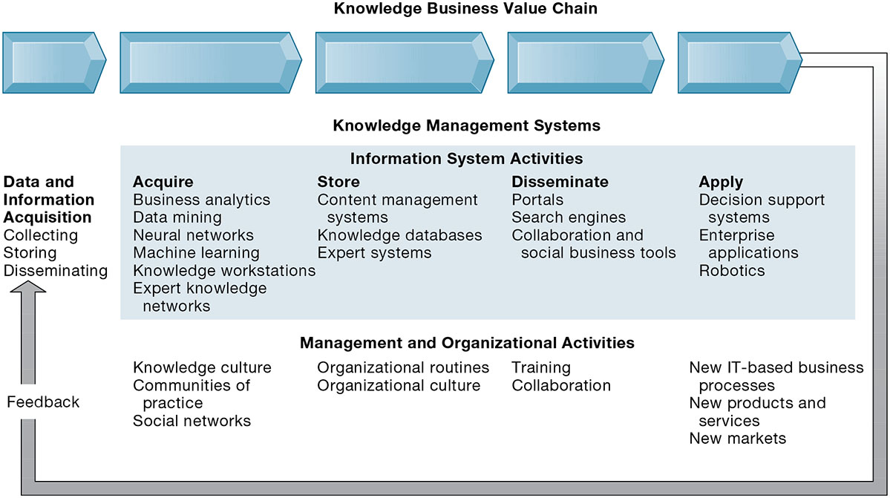
Figure 11.1 The Knowledge Management Value Chain
Notes:
Figure 11.1, Page 424.
Knowledge management today involves both information systems activities and a host of enabling management and organizational activities.
This graphic details the stages of the knowledge management value chain, separating the information system activities from the management/organizational activities involved at each stage. It also describes two other very important requirements for the value chain, the initial data and information acquisition that forms the basis for creating knowledge, and feedback from the knowledge application stage that can result in new opportunities for data and knowledge creation.
Full description: A knowledge business value chain begins with Data and Information Acquisition. Activities involved here include collecting, storing, and disseminating. The next part of the knowledge business value chain is knowledge management systems, which consist of the following information system activities. 1, Acquire. Knowledge discovery, data mining, neural networks, genetic algorithms, knowledge workstations, and expert knowledge networks. 2, Store. Content management systems, knowledge databases, and expert systems. 3, Disseminate. Portals, search engines, and collaboration and social business tools. 4, Apply. Decision support systems, enterprise applications, and robotics. Management and organizational activities relate to each of the following information system activities.1, Acquire. Knowledge culture, communities of practice, social networks, organizational practices and routines. 2, Store. Organizational routines, organizational culture. 3, Disseminate. Training, informal networks, organizational culture. 4, Apply. New I T based business processes, new products and services, and new markets. And throughout these activities, an organization obtains feedback that it can apply to data and information acquisition in refining and improving the knowledge management value chain.

Slide 13
Building Organizational and Management Capital: Collaboration, Communities of Practice, and Office Environments
Developing new organizational roles and responsibilities for the acquisition of knowledge
Chief knowledge officer executives
Dedicated staff / knowledge managers
Communities of practice (C O P s)
Informal social networks of professionals and employees
Activities include education, online newsletters, sharing knowledge
Reduce learning curves of new employees
Notes:
This slide discusses the new types of organizational roles that managers can develop in order to facilitate the knowledge value chain. Why might a chief knowledge officer, a senior executive position, be valuable to a company? Ask students why a CKO and COP may or may not be important to the various stages of the value chain—data acquisition, knowledge creation, storage, dissemination, and application, as well as feedback.

Slide 14
Types of Knowledge Management Systems
Enterprise-wide knowledge management systems
General-purpose firm-wide efforts to collect, store, distribute, and apply digital content and knowledge
Knowledge work systems (K W S)
Specialized systems built for engineers, scientists, other knowledge workers charged with discovering and creating new knowledge
Intelligent techniques
Diverse group of techniques such as data mining used for various goals: discovering knowledge, distilling knowledge, discovering optimal solutions
Notes:
This slide introduces the three main categories of information system used to manage knowledge. These categories are different in terms of the constituencies they serve, the purpose for which they are used, and what they emphasize.

Slide 15
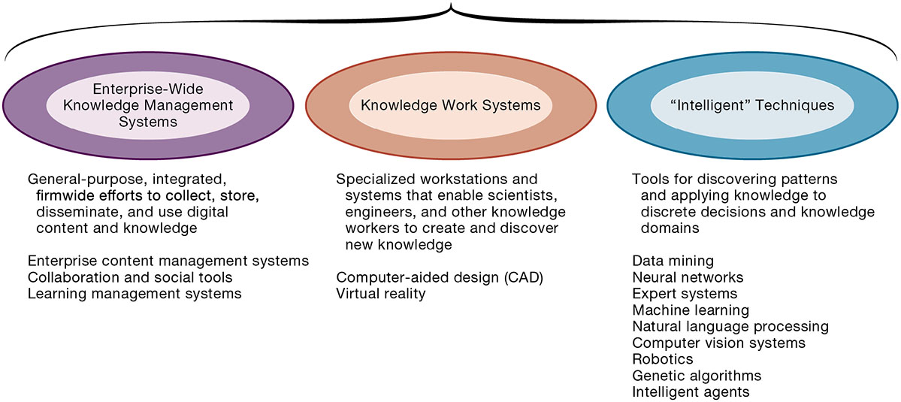
Figure 11.2 Major Types of Knowledge Management Systems
Notes:
Figure 11.2, Page 426.
There are three major categories of knowledge management systems, and each can be broken down further into more specialized types of knowledge management systems.
This graphic illustrates the three major types of knowledge management systems, giving the purpose of the system and examples of the type of system. Ask the students how they would categorize a system that catalogs and stores past advertising campaigns? What about software that helps a research biologist input and analyze lab findings?
Full description: A Diagram lists major types of knowledge management systems. Enterprise Wide Knowledge Management Systems are general-purpose, integrated, firmwide efforts to collect, store, disseminate, and use digital content and knowledge. Some examples are as follows. Enterprise content management systems. Collaboration and social tools. Learning management systems. Knowledge Work Systems are specialized workstations and systems that enable scientists, engineers, and other knowledge workers to create and discover new knowledge. Examples are: Computer aided design, or C A D. Virtual reality. Intelligent Techniques are tools for discovering patterns and applying knowledge to discrete decisions and knowledge domains. Examples include: Data mining. Neural networks. Expert systems. Machine learning. Natural language processing. Computer vision systems. Robotics. Genetic algorithms. Intelligent agents.

Slide 16
What Types of Systems Are Used for Enterprise-Wide Knowledge Management?
Three major types of knowledge in an enterprise
Structured documents
Reports, presentations
Formal rules
Semistructured documents
E-mails, videos
Unstructured, tacit knowledge
80% of an organization’s business content is semistructured or unstructured
Notes:
This slide describes the three major kinds of knowledge that can be found in an enterprise, and indicates that less formal knowledge may be just as critical as formal knowledge for organizations to store and share. Ask the students for other examples of semistructured and unstructured knowledge. Ask students for an example of tacit knowledge that is more important than structured knowledge such as a report.

Slide 17
What Is Artificial Intelligence? (1 of 3)
Grand vision
Computer hardware and software systems that are as “smart” as humans
So far, this vision has eluded computer programmers and scientists
Realistic vision
Systems that take data inputs, process them, and produce outputs (like all software programs) and that can perform many complex tasks that would be difficult or impossible for humans to perform.
Notes:
The grand vision of AI is very different from the reality of AI. Popular press accounts tend to emphasize the grand vision of AI, and are less observant of the real applications of AI. Real world applications can do things that humans cannot such as search a billion web pages to find the best responses to a search query in a few milliseconds, or identify faces in a crowd of thousands of street demonstrators, or identify patterns in Bid Data databases with millions of records.

Slide 18
What Is Artificial Intelligence? (2 of 3)
Examples:
Recognize millions of faces in seconds
Interpret millions of C T scans in minutes
Analyze millions of financial records
Detect patterns in very large Big Data databases
Improve their performance over time (“learn”)
Navigate a car in certain limited conditions
Respond to questions from humans (natural language); speech activated assistants like Siri, Alexa, and Cortana

Slide 19
What Is Artificial Intelligence? (3 of 3)
Major Types of A I
Expert systems
Machine learning
Neural networks and deep learning networks
Genetic algorithms
Natural language Processing
Computer vision
Robotics

Slide 20
Capturing Knowledge: Expert Systems
Capture tacit knowledge in very specific and limited domain of human expertise
Capture knowledge as set of rules
Typically perform limited tasks
Diagnosing malfunctioning machine
Determining whether to grant credit for loan
Used for discrete, highly structured decision making
Knowledge base: Set of hundreds or thousands of rules
Inference engine: Strategy used to search knowledge base
Forward chaining
Backward chaining
Notes:
This slide describes expert systems, one type of intelligent technique. Ask students why expert systems are best used in highly structured decision-making situations. Ask students to provide an example of a decision that could not be solved by an expert system. Choice of music, potential spouses or mates, new product decisions, or designing a new marketing campaign might be good examples of poorly structured decision situations.
This slide continues the discussion of expert systems and describes how they work. Their key elements are their knowledge base and their inference engine. Ask students to demonstrate an understanding of the difference between forward chaining and backward chaining. For example, given a hypothesized expert system to determine what to make for dinner, what would an inference engine with forward chaining begin with? (Example, is there chicken? Is there beef? Is there broccoli, etc.? What are all the ingredients available and what could be made from them?) What would an inference with backward chaining begin with? (We are making chicken with broccoli. Do we have the ingredients?)

Slide 21
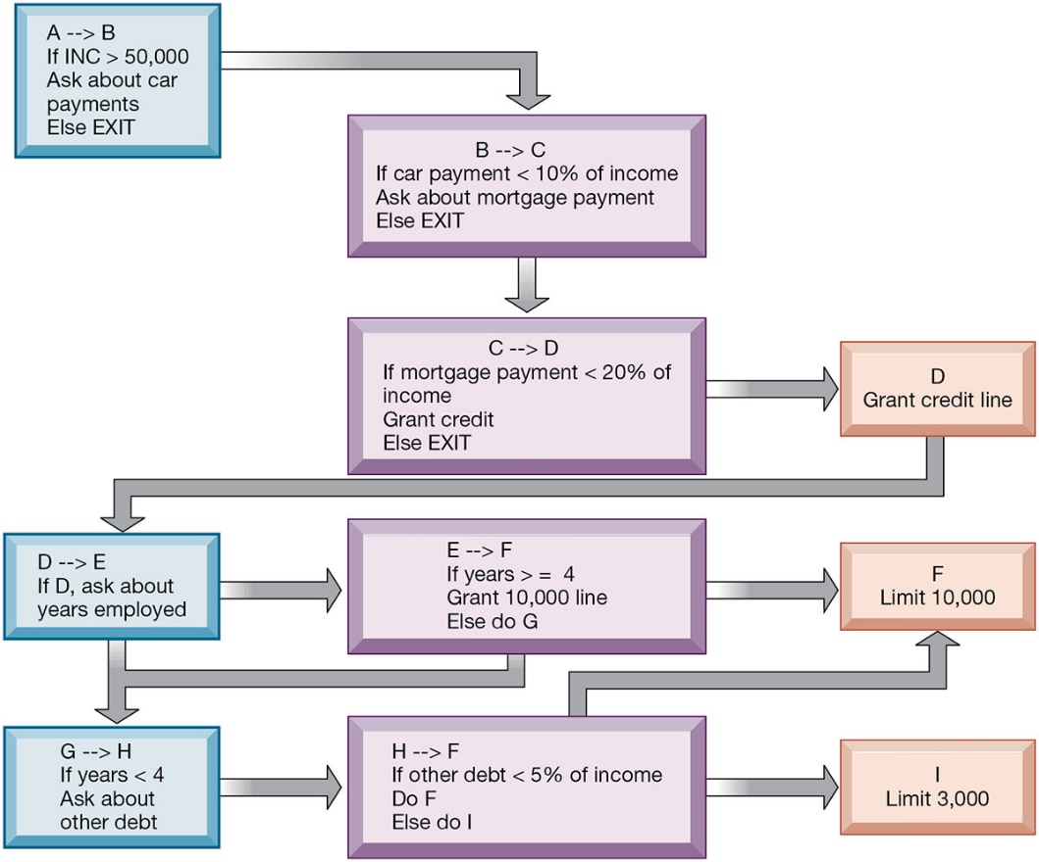
Figure 11.3 Rules in an Expert System
Notes:
Figure 11.5, Page 429.
An expert system contains a number of rules to be followed. The rules are interconnected, the number of outcomes is known in advance and is limited, there are multiple paths to the same outcome, and the system can consider multiple rules at a single time. The rules illustrated are for simple credit-granting expert systems.
This graphic illustrates the use of if/then rules in an expert system. Ask students to demonstrate an understanding of if/then rules, by analyzing a common decision as a series of if/then statements; for example, the decision to accept an invitation to socialize on a weeknight, or the decision of what to make for dinner.
Full description: A Diagram depicts the example of rules in an expert system. A to B, If I N C is greater than 50000, Ask about car payments, Else, EXIT. B to C, If car payment is less than 10 percent of income, Ask about mortgage payment, Else, EXIT. C to D, If mortgage payment is less than 20 percent of income, Grant credit, Else, EXIT. D, Grant credit line. D to E, If D, ask about years employed. E to F, If years greater than or equal to 4, Grant 10000 line, Else, do G. F, Limit 10000. G to H, If years less than 4, Ask about other debt. H to F, If other debt is less than 5 percent of income, Do F, Else, do I. I, Limit 3000.

Slide 22
Machine Learning
How computer programs improve performance without explicit programming
Recognizing patterns
Experience
Prior learnings (database)
Supervised vs. unsupervised learning
Contemporary examples
Google searches
Recommender systems on Amazon, Netflix
Notes:
Ask students if they have used Netflix, or Amazon recommender systems. How well did the recommender systems help them find other products to buy or movies to watch?

Slide 23
Neural Networks
Find patterns and relationships in massive amounts of data too complicated for humans to analyze
“Learn” patterns by searching for relationships, building models, and correcting over and over again
Humans “train” network by feeding it data inputs for which outputs are known, to help neural network learn solution by example from human experts.
Used in medicine, science, and business for problems in pattern classification, prediction, financial analysis, and control and optimization
Notes:
This slide discusses a fourth intelligent technique, neural networks. Ask students whether neural networks could be used in medical diagnosis? How would this work? To some extent, data mining techniques have replaced neural networks in situations requiring pattern recognition. For instance, credit card companies sift through mountains of transaction data to identify which charging patterns are unlikely for each and every charge card customer.

Slide 24
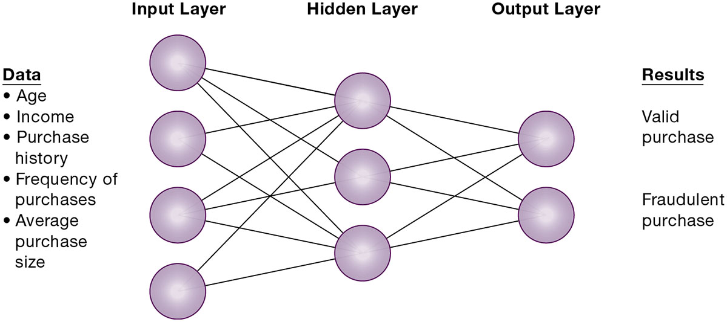
Figure 11.4 How a Neural Network Works
Notes:
Figure 11.4, Page 433.
A neural network uses rules it “learns” from patterns in data to construct a hidden layer of logic. The hidden layer then processes inputs, classifying them based on the experience of the model. In this example, the neural network has been trained to distinguish between valid and fraudulent credit card purchases.
This graphic illustrates how a neural network works—by using an internal, hidden layer of logic that examines existing data and assigning a classification to that set of data. For example, given one or more specific combinations of age, income, purchase history, frequency of purchases, and average purchase size, a neural network might determine that a new credit card purchase was likely to be fraudulent. What are the benefits and drawbacks of using this type of technique?
Full description: The input layer of the neural network includes a node for each of the following data. Age, Income, Purchase history, Frequency of purchases, Average purchase size. Each of these nodes connects with each of the three nodes in the hidden layer. Each of the three nodes in the hidden layer connects with each of the two result nodes, which are respectively labeled as follows. Valid purchase, Fraudulent purchase.

Slide 25
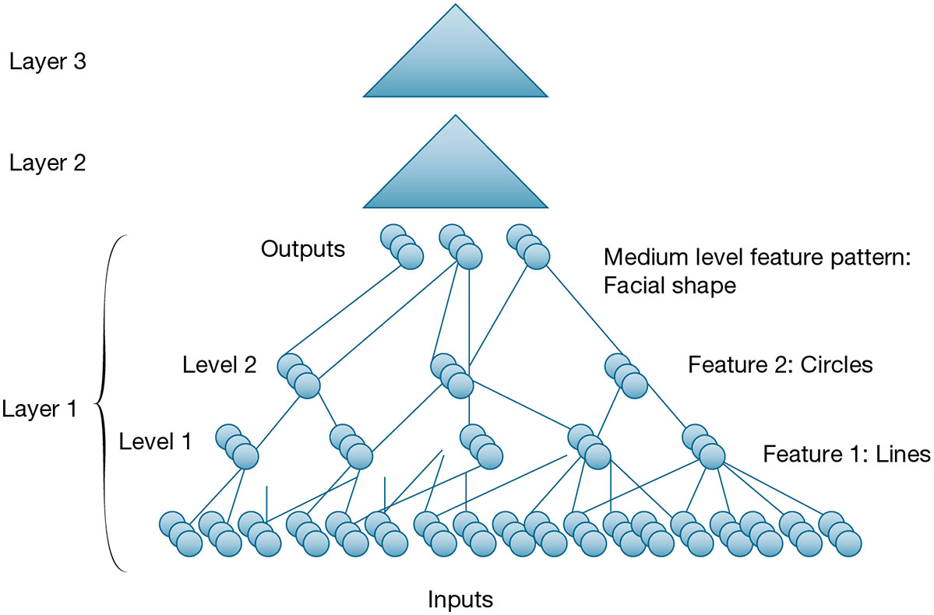
Figure 11.5 A Deep Learning Network
Notes:
Figure 11.5, Page 434.
Deep learning networks consist of many layers of neural networks working in a hierarchical fashion to detect patterns. Shown here is an expanded look at layer 1. Other layers have the same structure.
Full description: A diagram illustrates a deep learning network. It shows three layers. At the bottom, layer 1 shows a multitude of circles, or nodes, described as inputs. These are connected with lines to five sets of nodes that are labeled as Level 1 and Feature 1. Lines. The nodes in this level 1 are connected by lines to three sets of nodes, labeled as Level 2 and Feature 2. Circles. The Level 2 nodes are connected to three sets of circles that are labeled Outputs and Medium level feature pattern: Facial shape. Above the depiction of nodes is a triangle labeled Layer 2. Above this is another triangle labeled Layer 3.

Slide 26
Genetic Algorithms
Useful for finding optimal solution for specific problem by examining very large number of possible solutions for that problem
Conceptually based on process of evolution
Search among solution variables by changing and reorganizing component parts using processes such as inheritance, mutation, and selection
Used in optimization problems (minimization of costs, efficient scheduling, optimal jet engine design) in which hundreds or thousands of variables exist
Able to evaluate many solution alternatives quickly
Notes:
This slide discusses a fifth type of intelligent technique—genetic algorithms. Ask students whether genetic algorithms might be useful in medical diagnosis. Why or why not? Ask students to differentiate between the various intelligent techniques discussed this far—expert systems, CBR, fuzzy logic, neural networks, and genetic algorithms.

Slide 27
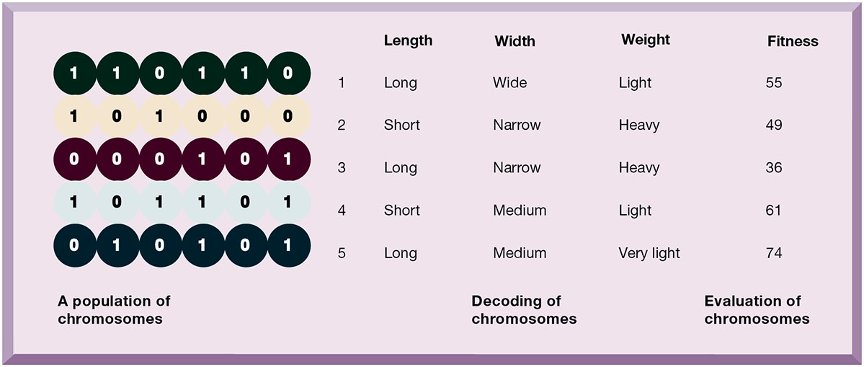
Figure 11.6 The Components of a Genetic Algorithm
Notes:
Figure 11.10, Page 435.
This example illustrates an initial population of “chromosomes,” each representing a different solution. The genetic algorithm uses an iterative process to refine the initial solutions so that the better ones, those with the higher fitness, are more likely to emerge as the best solution.
This graphic illustrates the components of a genetic algorithm—“chromosomes”, each with a variety of characteristics that can be compared for overall fitness in a given situation. Ask students what types of problems genetic algorithms are suited for.
Full description: A table on components of a genetic algorithm has 5 columns, labeled as follows. Population of chromosomes primary name, Population of chromosomes secondary name, Decoding of chromosomes length, Decoding of chromosomes width, Decoding of chromosomes weight, Evaluation of chromosomes fitness. Row 1. Population of chromosomes primary name. 1. Population of chromosomes secondary name. 1 1 0 1 1 0. Decoding of chromosomes length. Long. Decoding of chromosomes width. Wide. Decoding of chromosomes weight. Light. Evaluation of chromosomes fitness. 55. Row 2. Primary name. 2. Secondary name. 1 0 1 0 0 0. Length. Short. Width. Narrow. Weight. Heavy. Fitness. 49. Row 3. Primary name. 3. Secondary name. 0 0 0 1 0 1. Length. Long. Width. Narrow. Weight. Heavy. Fitness. 36. Row 4. Primary name. 4. Secondary name. 1 0 1 1 0 1. Length. Short. Width. Medium. Weight. Light. Fitness. 61. Row 5. Primary name. 5. Secondary name. 0 1 0 1 0 1. Length. Long. Width. Medium. Weight. Very light. Fitness. 74.

Slide 28
Natural Language Processing
Understand, and speak in natural language. Read natural language and translate
Typically today based on machine learning, aided by very large databases of common phrases and sentences in a given language
Example: Google Translate
Spam filtering systems
Customer call center interactions: What is the customer’s problem? What solutions worked in the past?
Digital assistances: Sire, Alexa, Cortana, Google Assistant
Not useful for an ordinary common sense human conversation but can be very useful in limited domains, e.g. interacting with your car’s heating system.
Notes:
Ask students to describe their experiences using digital assistants like Siri, Alexa, or Cortana.

Slide 29
Computer Vision Systems
Digital image systems that create a digital map of an image (like a face, or a street sign), and recognize this image in large data bases of images in near real time
Every image has a unique pattern of pixels
Facebook’s DeepFace can identify friends in photos across their system, and the entire web
Autonomous vehicles can recognize signs, road markers, people, animals, and other vehicles with good reliability
Industrial machine (robot) vision
Passport control at airports
Identifying people in crowds
Notes:
Can computer vision systems detect an imposter using makeup, or a recently grown beard? Or when people age and their faces change, can they be recognized by a computer vision system?

Slide 30
Robotics
Design, construction, and operation of machines that can substitute for humans in many factory, office, and home applications (home vacuums).
Generally programmed to perform specific and detailed actions in limited domains, e.g. robots spray paint autos, and assemble certain parts, welding, heavy assembly movement.
Used in dangerous situations like bomb disposal
Surgical robots are expanding their capabilities
Notes:
Ask students to recount any experiences they have had with robots in industry or in their homes.

Slide 31
Intelligent Agents
Work without direct human intervention to carry out repetitive, predictable tasks
Deleting junk e-mail
Finding cheapest airfare
Use limited built-in or learned knowledge base
Some are capable of self-adjustment, for example: Siri
Chatbots
Agent-based modeling applications:
Model behavior of consumers, stock markets, and supply chains; used to predict spread of epidemics
Notes:
This slide discusses the use of intelligent agents to carry out repetitive tasks for a user or system. Shopping bots discussed in an earlier chapter are an example of an intelligent agent. As an example of agent-based modeling, Procter & Gamble used agent-based modeling to improve coordination among supply-chain members. Siri, Apple’s “intelligent assistant,” is an example of a software program that can assist users in searching for content and answers to questions with a natural language interface. How many students have used Siri? What for?

Slide 32
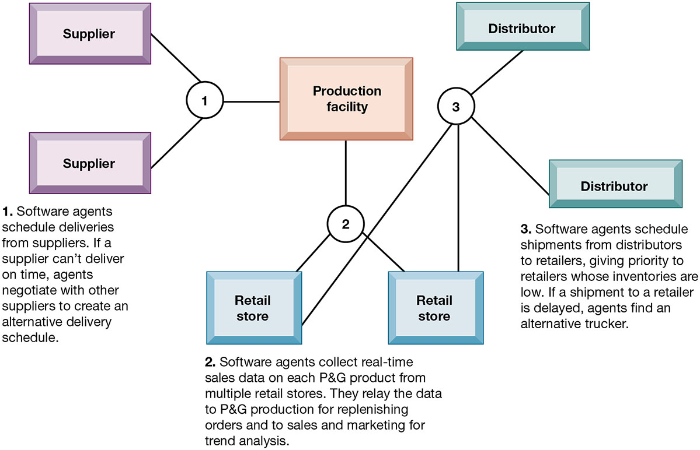
Figure 11.7 Intelligent Agents in P&G’s Supply Chain Network
Notes:
Figure 11.11, Page 439.
Intelligent agents are helping P&G shorten the replenishment cycles for products such as a box of Tide.
This graphic illustrates Procter & Gamble’s use of intelligent agents in its supply chain network. Given that intelligent-agent modeling mimics the behavior of a number of “actors” in a given situation, what other types of situations might benefit from this type of analysis?
Full description: A Diagram depicts placement of intelligent agents in a supply chain network. Intelligent agent 1 is located between production facility and two suppliers. Software agents schedule deliveries from suppliers. If a supplier can't deliver on time, agents negotiate with other suppliers to create an alternative delivery schedule. Intelligent agent 2 is located between production facility and two retail stores. Software agents collect real-time sales data on each P and G product from multiple retail stores. They relay the data to P and G production for replenishing orders and to sales and marketing for trend analysis. Intelligent agent 3 is located between two retail stores and two distributors. Software agents schedule shipments from distributors to retailers, giving priority to retailers whose inventories are low. If a shipment to a retailer is delayed, agents find an alternative trucker.

Slide 33
Enterprise Content Management Systems
Help capture, store, retrieve, distribute, preserve documents and semistructured knowledge
Bring in external sources
News feeds, research
Tools for communication and collaboration
Blogs, wikis, and so on
Key problem: developing taxonomy
Digital asset management systems
Notes:
This slide discusses the purpose and features of enterprise-wide content management systems. A first step in building such systems is describing a knowledge object (document) so that it can be found later by users. Companies must decide and implement classification schemes, or taxonomies, to define categories meaningful to users, and then knowledge objects must be assigned a classification (“tagged”) so that it can be retrieved. Ask students why different companies might need different taxonomies? Why is it a critical task and a difficult task in preparing for a successful content management system? Some content management systems specialize in managing digital media storage and classification. What types of firms may need these digital asset management systems? (publishers, advertisers, law firms, broadcasters, entertainment producers, etc.)

Slide 34
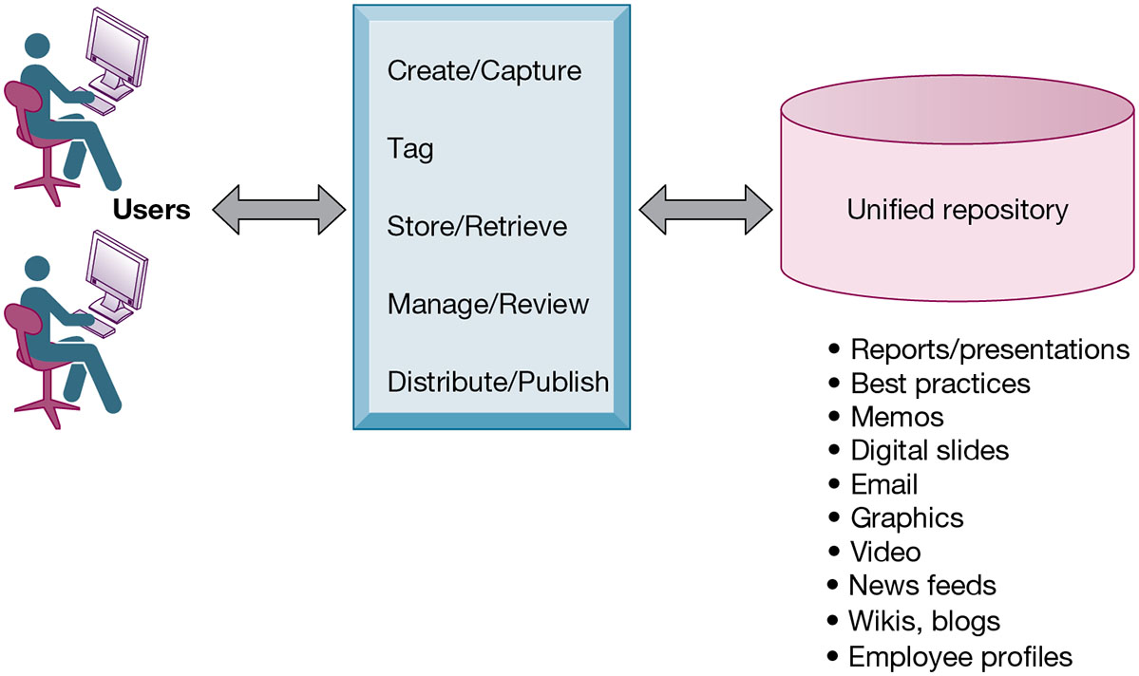
Figure 11.8 An Enterprise Content Management System
Notes:
Figure 11.3, Page 440.
An enterprise content management system has capabilities for classifying, organizing, and managing structured and semistructured knowledge and making it available throughout the enterprise.
This graphic illustrates the functions of an enterprise content management system. Users interact with the system to both input knowledge, manage it, and distribute it. These management systems can house a wide variety of information types, from formal reports to graphics, as well as bring in external content resources such as news feeds. Ask students what types of documents would need to be stored by a hospital, bank, law firm, and so on.
Full description: A unified repository of an enterprise content management system includes the following. Reports and presentations, Best practices, Memos, Digital slides, E mail, Graphics, Video, News feeds, Wikis, blogs, Employee profiles. Users use the system to create and capture, tag, store and retrieve, manage and review, and distribute and publish forms of knowledge that are part of the unified repository.

Slide 35
Locating and Sharing Expertise
Provide online directory of corporate experts in well-defined knowledge domains
Search tools enable employees to find appropriate expert in a company
Social networking and social business tools for finding knowledge outside the firm
Saving
Tagging
Sharing web pages
Notes:
Enterprise content management systems can include or consist of capabilities for the creation and management of unstructured knowledge. Ask the students to give examples of unstructured knowledge, given a type of industry or company: a law firm, an advertising firm, a school. What might be the difficulties in locating expertise in these firms? Contrast this network (crowd centered) approach to a top down structured knowledge management system.

Slide 36
Learning Management Systems (L M S)
Provide tools for management, delivery, tracking, and assessment of employee learning and training
Support multiple modes of learning
C D-R O M, web-based classes, online forums, and so on
Automates selection and administration of courses
Assembles and delivers learning content
Measures learning effectiveness
Massively open online courses (M O O C s)
Web course open to large numbers of participants
Notes:
This slide discusses learning management systems, which enable companies to track and manage employee learning. Ask students what are the benefits and drawbacks of using an LMS with centralized reporting.

Slide 37
Knowledge Workers and Knowledge Work
Knowledge workers
Researchers, designers, architects, scientists, engineers who create knowledge for the organization
Three key roles
Keeping organization current in knowledge
Serving as internal consultants regarding their areas of expertise
Acting as change agents, evaluating, initiating, and promoting change projects
Knowledge work systems
Systems for knowledge workers to help create new knowledge and integrate that knowledge into business
Notes:
This slide discusses the second main type of knowledge management system, the knowledge work system, and identifies the importance of knowledge workers to an organization and its knowledge creation. Ask the students why each of the three roles listed is important to an organization. Can all companies benefit from knowledge workers, or only design, science, and engineering firms?

Slide 38
Interactive Session: Management: Sargent & LundyLearns to Manage Employee Knowledge
Class discussion
How is knowledge management related to Sargent & Lundy’s business model?
Identify the knowledge management problem faced by Sargent & Lundy. What management, organization, and technology factors contributed to this problem?
Describe the solution selected for this problem. Was it effective? Why or why not? How much did it change the firm’s operations and decision making?
What management, organization, and technology issues had to be addressed in selecting and implementing the solution?

Slide 39
Requirements of Knowledge Work Systems
Sufficient computing power for graphics, complex calculations
Powerful graphics and analytical tools
Communications and document management
Access to external databases
User-friendly interfaces
Optimized for tasks to be performed (design engineering, financial analysis)
Notes:
This slide continues the discussion of knowledge work systems, emphasizing the need of knowledge workers to have highly specialized knowledge work systems. Ask students to describe the reasons that these characteristics are important for a knowledge work system. What other types of information systems would a knowledge worker rely on, if any? (office systems, productivity systems, scheduling systems)

Slide 40
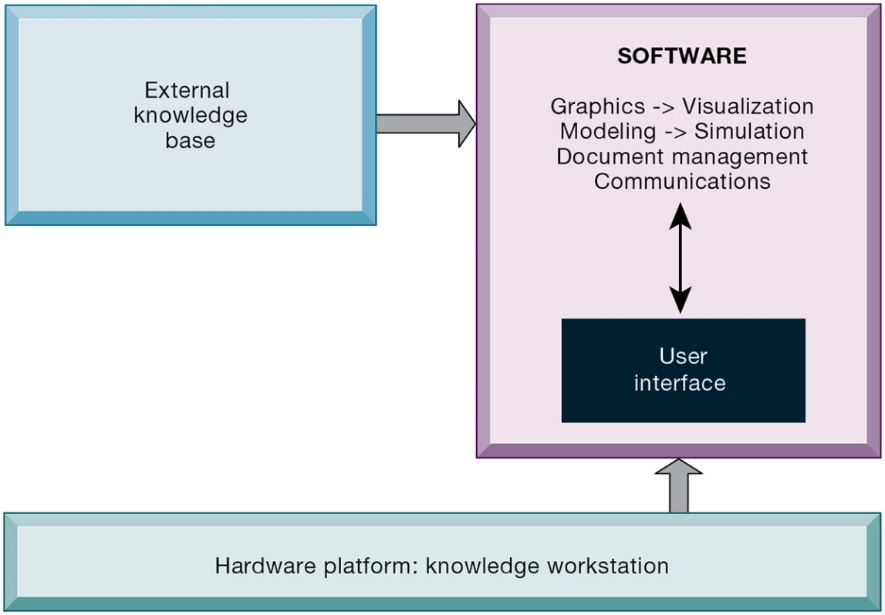
Figure 11.9 Requirements of Knowledge Work Systems
Notes:
Figure 11.4, Page 444.
Knowledge work systems require strong links to external knowledge bases in addition to specialized hardware and software.
This graphic illustrates the main components of a knowledge work station: having the need for both specialized software and hardware, access to external information, and an easy-to-use interface. What types of external knowledge might be valuable to an engineer, a financial analyst, a medical researcher?
Full description: A knowledge work system consists of graphics and visualization, modeling and simulation, document management, and communications software that communicate with the user through a user interface. In order to function, the system also requires an external knowledge base and a hardware platform in the form of a knowledge workstation.

Slide 41
Examples of Knowledge Work Systems
C A D (computer-aided design)
Creation of engineering or architectural designs
3D printing
Virtual reality systems
Simulate real-life environments
3D medical modeling for surgeons
Augmented reality (A R) systems
V R M L
Notes:
This slide describes three types of knowledge work systems: CAD systems and virtual reality systems. Ask students what the business value of providing a financial analyst, engineer, or researcher with an improved, specialized work station would be. Can the value of implementing or upgrading work systems be quantified into a monetary value?
Note that Augmented reality (AR) is a related technology for enhancing visualization. AR provides a live direct or indirect view of a physical real-world environment whose elements are augmented by virtual computer-generated imagery. The user is grounded in the real physical world, and the virtual images are merged with the real view to create the augmented display. What other industries might benefit from the use of virtual reality systems by their knowledge workers?

Slide 42
What Are the Business Benefits of Using Intelligent Techniques for Knowledge Management?
Intelligent techniques: Used to capture individual and collective knowledge and to extend knowledge base
To capture tacit knowledge: Expert systems, case-based reasoning, fuzzy logic
Knowledge discovery: Neural networks and data mining
Generating solutions to complex problems: Genetic algorithms
Automating tasks: Intelligent agents
Artificial intelligence (A I) technology:
Computer-based systems that emulate human behavior
Notes:
This slide introduces the third of the three main types of knowledge management systems, intelligent techniques, and categorizes them according to the type of knowledge involved. AI technology is used in some techniques as part of the logical computerized routine. The text discusses AI systems being able to learn languages, and emulate human expertise and decision making. What might be some of the benefits and drawbacks to AI technology? Are there any ethical considerations?

Slide 43
Interactive Session: Technology: The Reality of Virtual Reality
Class discussion
If your company wanted to implement a virtual reality application, what management, organization, and technology factors should it consider?
Should all businesses use virtual reality? Why or why not? What kinds of organizations will benefit most from this technology?
Do you think Facebook’s virtual reality strategy will be successful? Explain your answer.

Slide 44
How Will MIS Help My Career?
The Company: RazzleDazzle Technology
Position Description: Entry-level sales assistant
Job Requirements
Interview Questions
Author Tips

Slide 45

Copyright
This work is protected by United States copyright laws and is provided solely for the use of instructors in teaching their courses and assessing student learning. Dissemination or sale of any part of this work (including on the World Wide Web) will destroy the integrity of the work and is not permitted. The work and materials from it should never be made available to students except by instructors using the accompanying text in their classes. All recipients of this work are expected to abide by these restrictions and to honor the intended pedagogical purposes and the needs of other instructors who rely on these materials.

